Slide 1
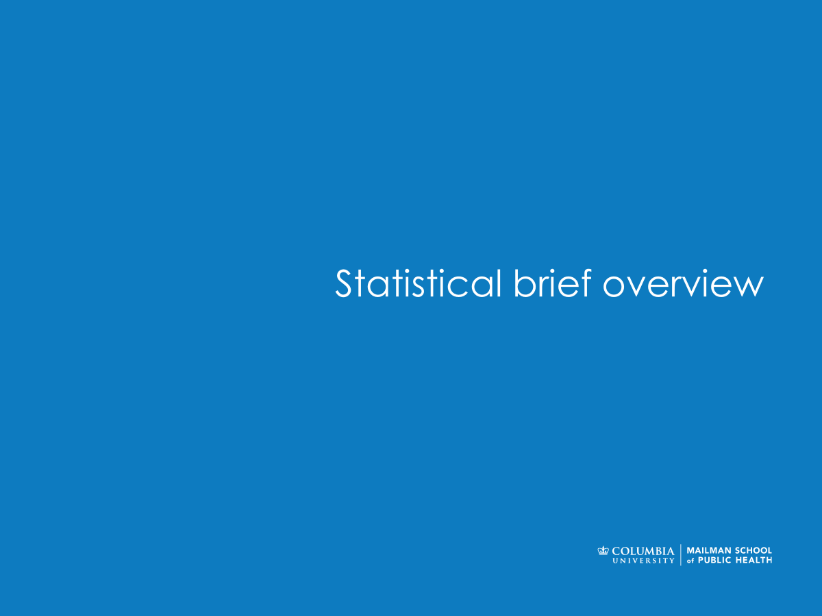

Computing in Context: Fall 2024
Lecture 3 | Tidy Data, Tidy Mind
Statistical brief overview
Dr Sarah Ashcroft-Jones | Mailman School of Public Health

Slide 2
Tidy Data
Does it spark joy?

Slide 3

“Tidy” Data?

Slide 4
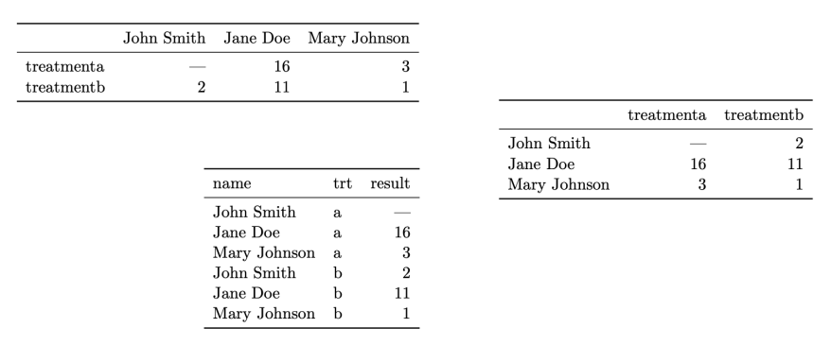
“Tidy” Data?
Same data, different organization.
Which one is best for data analysis?

Slide 5
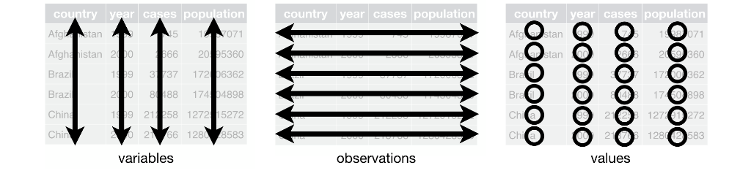
“Tidy” Datasets
Three interrelated rules which make a dataset tidy:
Each variable must have its own column.
Each observation must have its own row.
Each value must have its own cell.
https://byuidatascience.github.io/python4ds/tidy-data.html

Slide 6
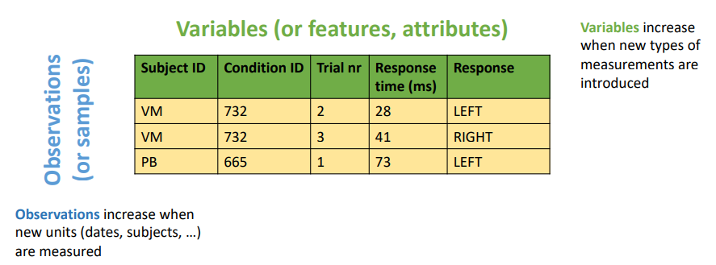
“Tidy” Datasets

Slide 7
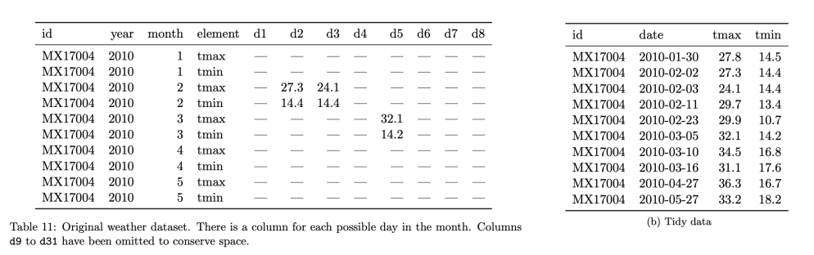
“Tidy” Datasets
Identify variables, observations, and values. What would a tidy version look like?

Slide 8
“Tidy” Datasets
Identify variables, observations, and values. What would a tidy version look like?

Slide 9
“Messy” data – prepare yourselves

Slide 10
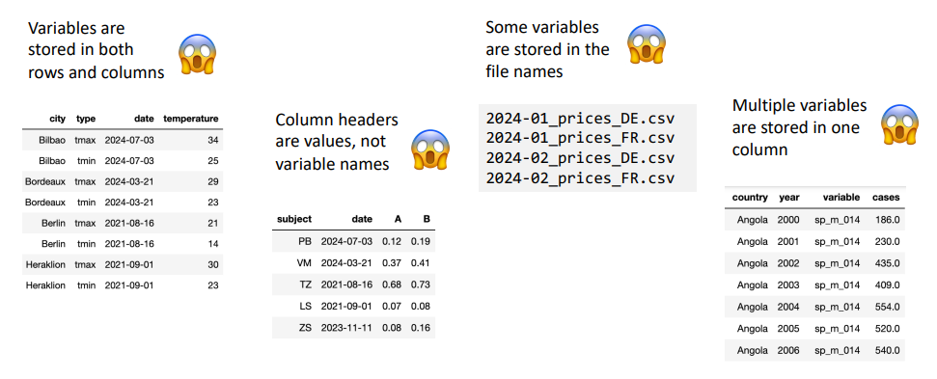
“Messy” data

Slide 11
“Messy” data

Slide 12
“Messy” data

Slide 13
“Messy” data

Slide 14
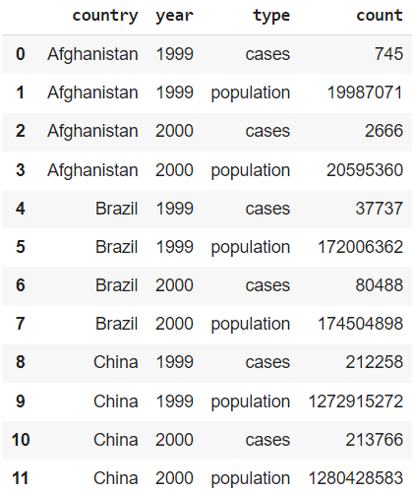
Messy Datasets - Too Long?
Messy!
What’s wrong here?

Slide 15
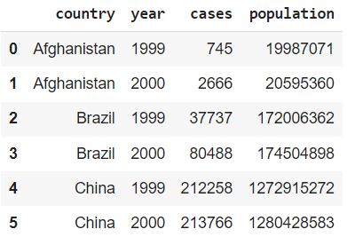
Messy Datasets - Too Long?
Messy!
What’s wrong here?
Each variable does not have its own column!
Tidy!
Notes:
So … what can we actually do if our data is too long and needs to be wider?

Slide 16


Slide 17
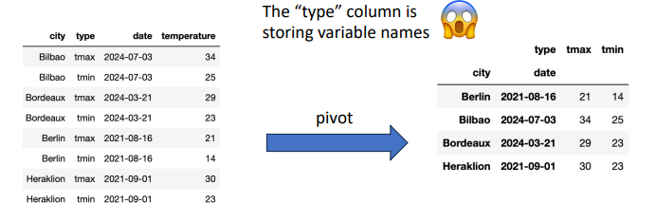
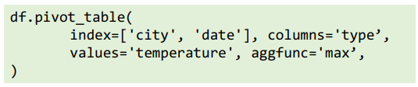
The life-changing magic of tidying your data

Slide 18
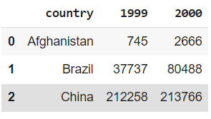
Messy Datasets - Too Wide?
Messy!
What’s wrong here?

Slide 19
Messy Datasets - Too Wide?
Messy!
Tidy!
What’s wrong here?
Each observation (country-year) does not have its own row!
Notes:
So what can we actually do?

Slide 20


Slide 21
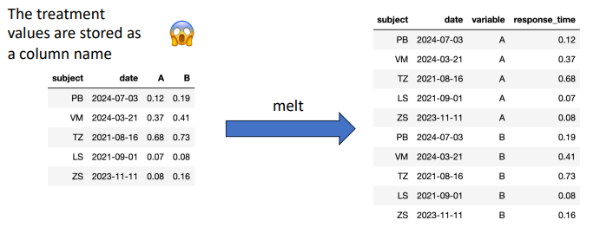

The life-changing magic of tidying your data

Slide 22
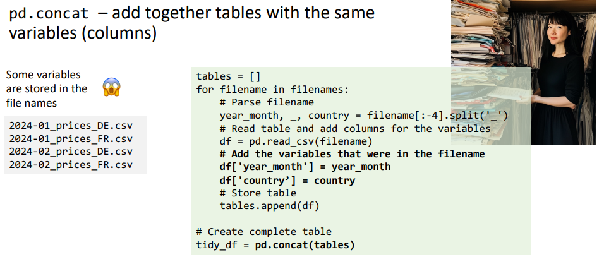
The life-changing magic of tidying your data
Notes:
Break from pivots and melts to a more specific use case – but looks like more common pythonic problem you might be used to from Q!

Slide 23
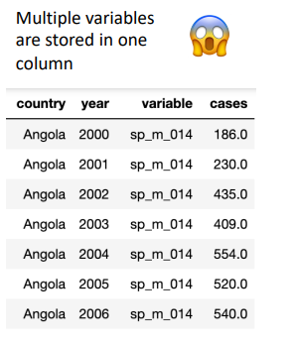
The life-changing magic of tidying your data
Sometimes you’ll want to “separate” the strings in a column into two separate columns.
Other times you’ll want to “unite” (i.e., concatenate) the strings in two columns into a single column.

Slide 24
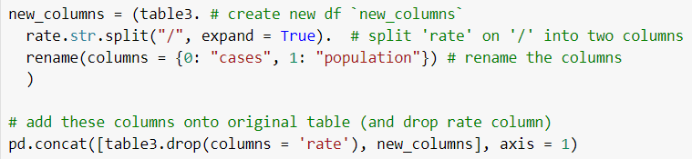
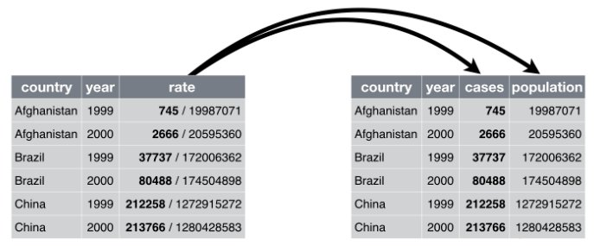
Separating
Sometimes you’ll want to “separate” the strings in a column into two separate columns.
https://byuidatascience.github.io/python4ds/tidy-data.html

Slide 25
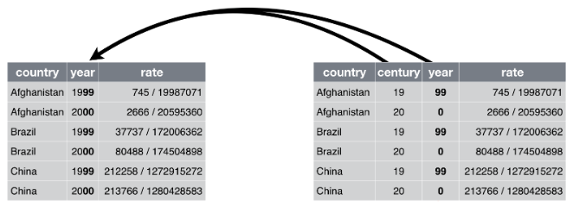
Uniting
Other times you’ll want to “unite” (i.e., concatenate) the strings in two columns into a single column.
https://byuidatascience.github.io/python4ds/tidy-data.html

Slide 26
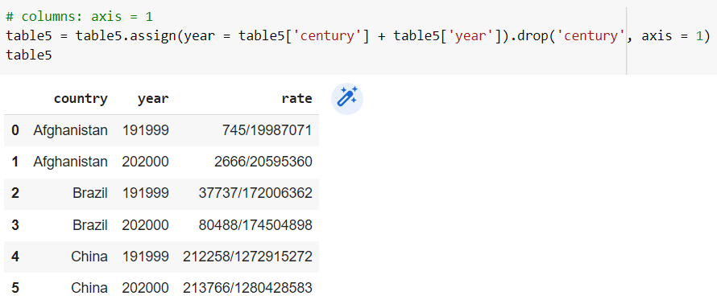
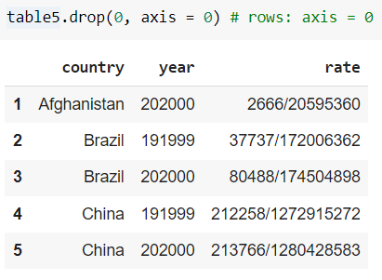
Note “axis” parameter
Rows: axis = 0
Columns: axis = 1

Slide 27
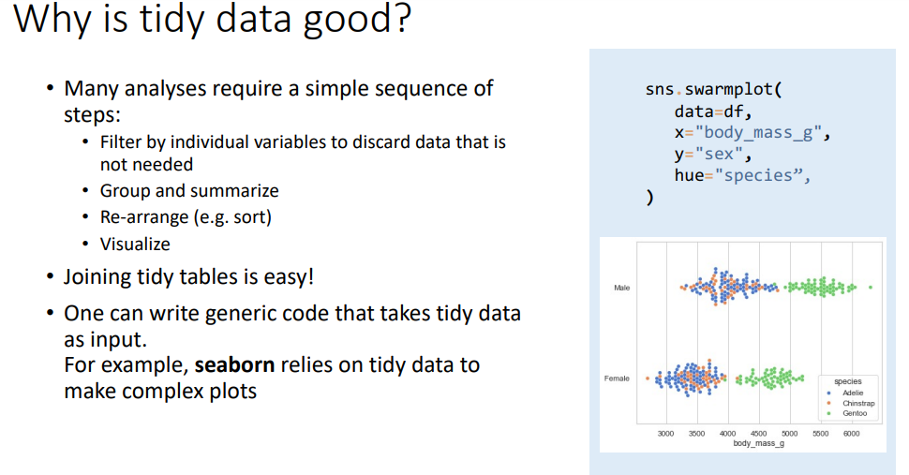

Slide 28
Data De-Duplication
Another potential headache

Slide 29
Data de-duplication
What if instead of missing data, you have too many values? If you have too many versions of the same information, it could lead to misleading analyses.
You need to find some way to de-duplicate/unify the records at the level of analysis. Sounds easy, right?

Slide 30
Duplicates – Level I: Annoying
Pure duplicates in your data.
Example
Whoever was responsible for transferring data from the hospital’s EHR system to your database accidentally did it twice.
Solution
Simple: drop the duplicate.
ID | Name | Sex | Age
80415 | Sterling Archer | M | 34
85148 | Lana Kane | F | 33
61598 | Pam Poovey | F | 35
61598 | Pam Poovey | F | 35
21846 | Cyrill Figgis | M | 40
51487 | Cheryl Tunt | F | 31
32545 | Ray Gillette | M | 37

Slide 31
Duplicates – Level II: Frustrating
Another form of duplication: data pertaining to a single entity is entered as if it is multiple entities. Example: A patient has an existing EHR file at a hospital. Upon returning to the hospital, a hospital employee mistakenly creates a new EHR file for this patient, rather than simply adding the most recent visit to the patient’s existing record.
ID | Name | Sex | Age
80415 | Sterling Archer | M | 34
85148 | Lana Kane | F | 33
61598 | Pam Poovey | F | 35
63579 | Pam Poovey | F | 35
21846 | Cyrill Figgis | M | 40
51487 | Cheryl Tunt | F | 31
32545 | Ray Gillette | M | 37

Slide 32
Duplicates – Level II: Frustrating
ID | Name | Sex | Age
80415 | Sterling Archer | M | 34
85148 | Lana Kane | F | 33
61598 | Pam Poovey | F | 35
63579 | Pam Poovey | F | 35
21846 | Cyrill Figgis | M | 40
51487 | Cheryl Tunt | F | 31
32545 | Ray Gillette | M | 37
Solution: Assuming enough identifying information was entered correctly in both files (DOB, sex, name, etc) …
Relatively straightforward to identify the duplicate in the data and combine the two records.

Slide 33
Duplicates – Level III: Exasperating
Another form of duplication: when data pertaining to a single entity is entered as if it is multiple entities, and identifying information is mis-recorded:
BUT you know which ones are wrong.
Example: Imagine that when the patient’s record is mistakenly duplicated, the name is misspelled. BUT you know the correct version.
ID | Name | Sex | Age
80415 | Sterling Archer | M | 34
85148 | Lana Kane | F | 33
61598 | Pam Poovey | F | 35
63579 | Pamm Poovey | F | 35
21846 | Cyrill Figgis | M | 40
51487 | Cheryl Tunt | F | 31
32545 | Ray Gillette | M | 37

Slide 34
Duplicates – Level III: Exasperating
Solution: It’s more difficult to identify the duplicates, since the identifying information is no longer identical.
Maybe use some kind of “fuzzy” string matching technique (using a string metric, like the “Hamming Distance” implemented in an early lab!) to identify if two names are likely to refer to the same person.
ID | Name | Sex | Age
80415 | Sterling Archer | M | 34
85148 | Lana Kane | F | 33
61598 | Pam Poovey | F | 35
63579 | Pamm Poovey | F | 35
21846 | Cyrill Figgis | M | 40
51487 | Cheryl Tunt | F | 31
32545 | Ray Gillette | M | 37

Slide 35
Duplicates – Level IV: Existential Despair
Now imagine you have many records which contain errors, all pertaining to the same entity, but you don’t know which one (if any) is correct.
Example: EHR data from a large city’s EMS service. However, their identifying information is collected haphazardly, resulting in several distinct records pertaining to a single patient. Worse yet, you don’t know which record is the “correct” one to link them to another database.
ID | Name | Sex | Age
80415 | Sterling Archer | M | 34
85148 | Lana Kane | F | 33
61598 | Pam Puvey | F | 35
63579 | Pamm Poovey | F | 35
89532 | Pam Poovey | F | 35
51487 | Cheryl Tunt | F | 31
32545 | Ray Gillette | M | 37

Slide 36
Duplicates – Level IV: Existential Despair
Solution: Cry.
When you’re done, spend countless hours figuring out how best to probabilistically link records.
Maybe using some kind of machine learning algorithm?
(may lead to more crying)
ID | Name | Sex | Age
80415 | Sterling Archer | M | 34
85148 | Lana Kane | F | 33
61598 | Pam Puvey | F | 35
63579 | Pamm Poovey | F | 36
89532 | Pam Poovey | F | 34
51487 | Cheryl Tunt | F | 31
32545 | Ray Gillette | M | 37
?
?
?

Slide 37
Data Copies or Alterations
A pox on thee…

Slide 38

Create new DFs, or alter existing DFs?
OR (important: what’s the difference?)

Slide 39
Create new DFs, or alter existing DFs?
Creates a new (overwrites existing) column within the original object `table5`
OR (important: what’s the difference?)
pd.assign() method returns a NEW DF object, called `table5`

Slide 40
Why might use of ‘assign()’ be preferable?
Common reasons:
You may want to avoid altering the original DF
Can “chain” methods (assign() and drop()) on a single line
But – may be more memory intensive

Slide 41
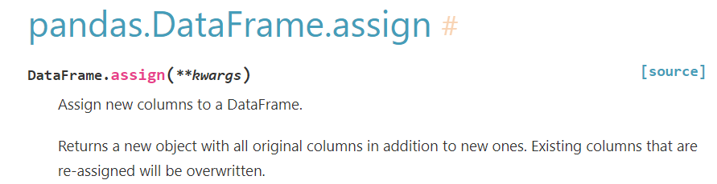
When in doubt, check documentation!
https://pandas.pydata.org/docs/reference/api/pandas.DataFrame.assign.html
Many DF methods like this, so be sure to use them properly!

Slide 42

Beware pandas`, inplace = ` option!
https://towardsdatascience.com/why-you-should-probably-never-use-pandas-inplace-true-9f9f211849e4

Slide 43
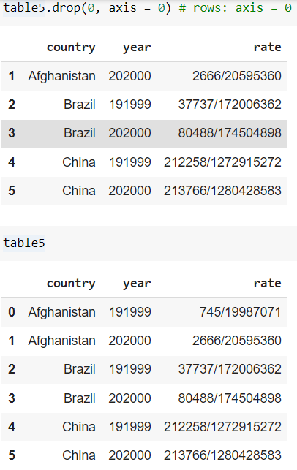
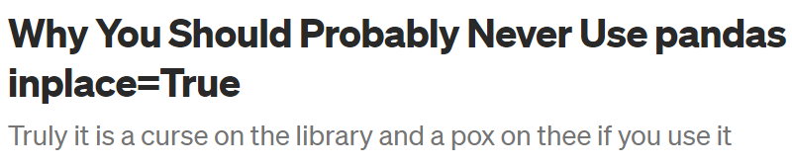
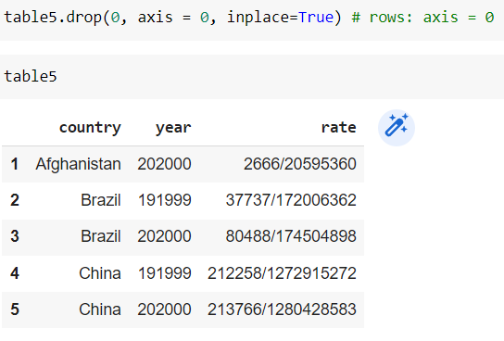
Beware pandas`, inplace = ` option!
https://towardsdatascience.com/why-you-should-probably-never-use-pandas-inplace-true-9f9f211849e4
vs.

Slide 44
Questions?
Statistical brief overview
Dr Sarah Ashcroft-Jones | Mailman School of Public Health

